Slide 3
ACTS 4:24
²⁴ …they lifted their voices to God with one accord... (NASB)
그들이 듣고 한마음으로 하나님께 소리를 높여... (행 4:24)

Slide 4
Romans 15:6
⁶ so that with one accord you may with one voice glorify the God andFather of our Lord Jesus Christ. (NASB)
한마음과 한 입으로 하나님 곧 우리 주 예수 그리스도의 아버지께 영광을 돌리게 하려 하노라 (롬 15:6)

Slide 5
John 17:20-23
²⁰ “My prayer is not for them alone. I pray also for those who will believe in me through their message, ²¹ that all of them may be one, Father, just as you are in me and I am in you. May they also be in us so that the world may believe that you have sent me. ²² I have given them the glory that you gave me, that they may be one as we are one: ²³ I in them and you in me. May they be brought to complete unity to let the world know that you sent me and have loved them even as you have loved me.

Slide 6
1 Corinthians 1:12
¹² What I mean is this: One of you says, “I follow Paul”; another, “I follow Apollos”; another, “I follow Peter”; still another, “I follow Christ.”

Slide 7
1 corinthians 1:13,3:3-4
¹³ Is Christ divided? Was Paul crucified for you? Were you baptized into the name of Paul?...
³ You are still worldly. For since there is jealousy and quarreling among you, are you not worldly? Are you not acting like mere men? ⁴ For when one says, “I follow Paul,” and another, “I follow Apollos,” are you not mere men?

Slide 8
1 corinthians 3:5-9
⁵ What, after all, is Apollos? And what is Paul? Only servants, through whom you came to believe—as the Lord has assigned to each his task. ⁶ I planted the seed, Apollos watered it, but God made it grow. ⁷ So neither he who plants nor he who waters is anything, but only God, who makes things grow. ⁸ The man who plants and the man who waters have one purpose, and each will be rewarded according to his own labor. ⁹ For we are God’s fellow workers;

Slide 9
1 corinthians 3:21
²¹ So then, no more boasting about men!

Slide 10
1 corinthians 12:12-13
¹² The body is a unit, though it is made up of many parts; and though all its parts are many [and diverse], they form one body. So it is with Christ. ¹³ For we were all baptized by one Spirit into one body—whether Jews or Greeks, slave or free—and we were all given the one Spirit to drink.

Slide 11
Ephesians 4:4-6
⁴ There is one body and one Spirit—just as you were called to one hope when you were called— ⁵ one Lord, one faith, one baptism; ⁶ one God and Father of all, who is over all and through all and in all.

Slide 12
Romans 15:6
⁶ so that with one accord you may with one voice glorify the God andFather of our Lord Jesus Christ. (NASB)
한마음과 한 입으로 하나님 곧 우리 주 예수 그리스도의 아버지께 영광을 돌리게 하려 하노라 (롬 15:6)

Slide 13
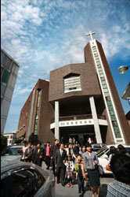
JUNGBU CHURCH
Service Time: 4:30pm Sunday
Location: 3rd floor of Edu. Bld.
Pastor: Brian Heldenbrand

Slide 14
Psalm 133
¹ How good and pleasant it is when brothers live together in unity! ² It is like precious oil poured on the head, running down on the beard, running down on Aaron’s beard, down upon the collar of his robes. ³ It is as if the dew of Hermon were falling on Mount Zion. For there the LORD bestows his blessing, even life forevermore.

Slide 15
Happy Day

Slide 16
The greatest day in history,

Slide 17
Death is beaten You have rescued me

Slide 18
Sing it out, Jesus is alive

Slide 19
The empty cross, the empty grave

Slide 20
Life eternal, You have won the day

Slide 21
Shout it all, Jesus is alive He´s alive

Slide 22
Oh happy day, happy day You washed my sin away

Slide 23
Oh happy day, happy day I'll never be the same

Slide 24
Forever I am changed

Slide 25
When I stand in that place

Slide 26
Free at last, meeting face to face

Slide 27
I am Yours, Jesus You are mine Endless joy, perfect peace

Slide 28
Earthly pain finally will cease Celebrate Jesus is alive He's alive

Slide 29
Oh happy day, happy day You washed my sin away

Slide 30
Oh happy day, happy day I'll never be the same

Slide 31
Oh what a glorious day What a glorious way That You have saved me

Slide 32
Oh what a glorious day What a glorious name

Slide 33
Oh happy day, happy day You washed my sin away

Slide 34
Oh happy day, happy day I'll never be the same

Slide 35
Forever I am changed

Slide 37
Psalm 27:4
One thing I ask from the LORD, this only do I seek: that I may dwell in the house of the LORD all the days of my life, to gaze on the beauty of the LORD and to seek him in his temple.

Slide 38
Beautiful One

Slide 39
Wonderful, so wonderful Is Your unfailing love

Slide 40
Your cross has spoken mercy over me

Slide 41
No eye has seen, No ear has heard No heart could fully know

Slide 42
How glorious, how beautiful you are!

Slide 43
Beautiful One I love Beautiful One I adore Beautiful One my soul must sing

Slide 44
Powerful, so powerful Your glory fills the skies

Slide 45
Your mighty works displayed for all to see

Slide 46
The beauty of Your majesty Awakes my heart to sing

Slide 47
How marvelous, how wonderful You are

Slide 48
Beautiful One I love Beautiful One I adore Beautiful One my soul must sing

Slide 49
Beautiful One I love Beautiful One I adore Beautiful One my soul must sing

Slide 50
Opened my eyes to Your wonders anew

Slide 51
You captured my heart with this love

Slide 52
‘cause nothing on earth is as beautiful as You

Slide 53
Opened my eyes to Your wonders anew

Slide 54
You captured my heart with this love

Slide 55
‘cause nothing on earth is as beautiful as You

Slide 56
Beautiful One I love Beautiful One I adore Beautiful One my soul must sing

Slide 57
My soul, my soul must sing My soul, my soul must sing My soul, my soul must sing Beautiful One

Slide 58
My soul, my soul must sing My soul, my soul must sing My soul, my soul must sing Beautiful One

Slide 59
Beautiful One I love Beautiful One I adore Beautiful One my soul must sing

Slide 60
Beautiful One I love Beautiful One I adore Beautiful One my soul must sing

Slide 62
Nehemiah 9:5-6
And the Levites—Jeshua, Kadmiel, Bani, Hashabneiah, Sherebiah, Hodiah, Shebaniah and Pethahiah—said: “Stand up and praise the LORD your God, who is from everlasting to everlasting.”
“Blessed be your glorious name, and may it be exalted above all blessing and praise. You alone are the LORD. You made the heavens, even the highest heavens, and all their starry host, the earth and all that is on it, the seas and all that is in them. You give life to everything, and the multitudes of heaven worship you.”

Slide 63
Blessed Be Your Name

Slide 64
Blessed Be Your Name In the land that is plentiful

Slide 65
Where Your streams of abundance flow Blessed be Your name

Slide 66
Blessed Be Your name When I'm found in the desert place

Slide 67
Though I walk through the wilderness Blessed Be Your name

Slide 68
Every blessing You pour out I'll turn back to praise

Slide 69
When the darkness closes in, Lord, Still I will say

Slide 70
Blessed be the name of the Lord Blessed be Your name

Slide 71
Blessed be the name of the Lord Blessed be Your glorious name

Slide 72
Blessed be Your name When the sun's shining down on me

Slide 73
When the world's all as it should be’ Blessed be Your name

Slide 74
Blessed be Your name On the road marked with suffering

Slide 75
Though there's pain in the offering Blessed be Your name

Slide 76
Every blessing You pour out I'll turn back to praise

Slide 77
When the darkness closes in, Lord, Still I will say

Slide 78
Blessed be the name of the Lord Blessed be Your name

Slide 79
Blessed be the name of the Lord Blessed be Your glorious name

Slide 80
You give and take away (x2)

Slide 81
My heart will choose to say Lord, blessed be Your name

Slide 82
You give and take away (x2)

Slide 83
My heart will choose to say Lord, blessed be Your name

Slide 84
Blessed be the name of the Lord Blessed be Your name

Slide 85
Blessed be the name of the Lord Blessed be Your glorious name

Slide 86
Blessed be the name of the Lord Blessed be Your name

Slide 87
Blessed be the name of the Lord Blessed be Your glorious name

Slide 89
1 Corinthians 13:4-8,13
⁴ Love is patient, love is kind. It does not envy, it does not boast, it is not proud. ⁵ It does not dishonor others, it is not self-seeking, it is not easily angered, it keeps no record of wrongs. ⁶ Love does not delight in evil but rejoices with the truth. ⁷ It always protects, always trusts, always hopes, always perseveres. ⁸ Love never fails…

Slide 90
Your Love Never Fails

Slide 91
I know I still make mistakes

Slide 92
But, You have new mercy
for me everyday

Slide 93
Your love never fails

Slide 94
I know I still make mistakes

Slide 95
But, You have new mercy
for me everyday

Slide 96
Your love never fails

Slide 97
You stay the same through the ages

Slide 98
Your love never changes

Slide 99
There may be pain in the night but joy comes with the morning

Slide 100
And when the oceans rage I don't have to be afraid

Slide 101
Because I know that You love me

Slide 102
Your love never fails

Slide 103
The wind is strong and the water's deep

Slide 104
But, I'm not alone here in these open seas

Slide 105
Cause Your love never fails

Slide 106
The chasm was far too wide I never thought

Slide 107
I'd reach the other side But Your love never fails

Slide 108
You stay the same through the ages

Slide 109
Your love never changes

Slide 110
There may be pain in the night but joy comes with the morning

Slide 111
And when the oceans rage I don't have to be afraid

Slide 112
Because I know that You love me

Slide 113
Your love never fails

Slide 114
You make all things work together for my good
x6

Slide 115
You stay the same through the ages

Slide 116
Your love never changes

Slide 117
There may be pain in the night but joy comes with the morning

Slide 118
And when the oceans rage I don't have to be afraid

Slide 119
Because I know that You love me

Slide 120
Your love never fails

Slide 122
Psalm 91:14
“Because he loves me,”
says the LORD,
“I will rescue him; I will protect him,
for he acknowledges my name…”

Slide 123
RESCUE

Slide 124
You are the source of life I can't be left behind

Slide 125
No one else will do I will take hold of You

Slide 126
I need You Jesus to come to my rescue Where else can I go?

Slide 127
There's no other name by which I am saved

Slide 128
Capture me with grace I will follow You

Slide 129
I need You Jesus to come to my rescue Where else can I go?

Slide 130
There's no other name by which I am saved

Slide 131
Capture me with grace I will follow You

Slide 132
My heart is yours for life I need your hand in mine

Slide 133
No one else will do I put my trust in You

Slide 134
I need you Jesus come to my rescue Tell me where else can I go?

Slide 135
There's no other name by which I am saved

Slide 136
Capture me with grace I will follow You

Slide 137
This world has nothing for me (x4)

Slide 138
I need you Jesus come to my rescue Where else can I go?

Slide 139
There's no other name by which I am saved

Slide 140
Capture me with your grace I will follow you

Slide 141
This world has nothing for me I will follow you

Slide 143
2 Chronicles 7:14
¹⁴ if my people, who are called by my name, will humble themselves and pray and seek my face and turn from their wicked ways, then I will hear from heaven, and I will forgive their sin and will heal their land.

Slide 144
Hear Us From Heaven

Slide 145
Lord, hear our cry Come heal our land

Slide 146
Breath life into these dry and thirsty souls

Slide 147
Lord, hear our prayer Forgive our sin

Slide 148
And as we call on Your name Would You make this a place For Your glory to dwell

Slide 149
Open the blind eyes Unlock the deaf ears

Slide 150
Come to Your people As we draw near

Slide 151
Hear us from heaven Touch our generation

Slide 152
We are Your people Crying out in desperation

Slide 153
Hear Us From Heaven, Hear Us From Heaven, Hear Us From Heaven
(x4)

Slide 154
Open the blind eyes Unlock the deaf ears

Slide 155
Come to Your people As we draw near

Slide 156
Hear us from heaven Touch our generation

Slide 157
We are Your people Crying out in desperation

Slide 159
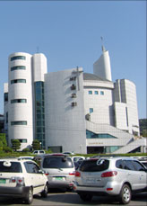
PAUL CHURCH
Service Time: 3:00pm Sunday
Location: Use upper (back) parking lot entrance
Pastor: Richard Nelson
Contact: David Van Minnen

Slide 160
ONE WAY
Jonathon Douglass & Joel Houston (G)

Slide 161
I lay my life down at Your feet
Cause You're the only one I need
I turn to You and
You are always there

Slide 162
In troubled times it's You I seek I put You first that's all I need I humble all I am, all to You

Slide 163
One way, Jesus! You're the only one that I could live for!
:||

Slide 164
You are always, always there Every how and every where Your grace abounds so deeply within me

Slide 165
You will never ever change Yesterday today the same Forever till forever meets no end

Slide 166
One way, Jesus! You're the only one that I could live for!
(x2)

Slide 167
You are the Way,
the Truth and the Life
We live by faith
and not by sight for You,
We're living all for You
(x2)

Slide 168
One way, Jesus! You're the only one that I could live for!
(x2)

Slide 169
One way, Jesus! You're the only one that I could live for!
:||

Slide 171
Because of who you are

Slide 172
Because of who You are,
I give You glory
Because of who You are,
I give You praise

Slide 173
Because of who You are,
I will lift my voice and say
Lord I worship You,
because of who You are

Slide 174
Because of who You are,
I give You glory
Because of who You are,
I give You praise

Slide 175
Because of who You are,
I will lift my voice and say
Lord I worship You,
because of who You are

Slide 176
Lord, I worship You,
because of who You Are

Slide 177
Jehovah Jireh: my Provider
Jehovah Nissi: Lord You reign in victory
Jehovah Shalom: my Prince of Peace

Slide 178
And I worship You,
because of who You Are

Slide 179
Because of who You are,
I give You glory
Because of who You are,
I give You praise

Slide 180
Because of who You are,
I will lift my voice and say
Lord I worship You,
because of who You are

Slide 181
Lord, I worship You,
because of who You Are

Slide 182
Jehovah Jireh: my Provider
Jehovah Nissi: Lord You reign in victory
Jehovah Shalom: my Prince of Peace

Slide 183
And I worship You,
because of who You Are

Slide 184
Jehovah Jireh: my Provider
Jehovah Nissi: Lord You reign in victory
Jehovah Shalom: my Prince of Peace

Slide 185
And I worship You,
because of who You Are

Slide 186
Lord, I worship You,
because of who You Are

Slide 188
MIGHTY TO SAVE
Hillsong (D)

Slide 189
Everyone needs compassion, Love that's never failing; Let mercy fall on me.

Slide 190
Everyone needs forgiveness, The kindness of a Savior; The Hope of nations.

Slide 191
Savior!
He can move the mountains, My God is Mighty to save, He is Mighty to save.

Slide 192
Forever, Author of salvation, He rose and conquered the grave, Jesus conquered the grave.

Slide 193
So take me as You find me, All my fears and failures, Fill my life again.

Slide 194
I give my life to follow Everything I believe in, Now I surrender.

Slide 195
Savior!
He can move the mountains, My God is Mighty to save, He is Mighty to save.

Slide 196
Forever, Author of salvation, He rose and conquered the grave, Jesus conquered the grave.

Slide 197
Savior!
He can move the mountains, My God is Mighty to save, He is Mighty to save.

Slide 198
Forever, Author of salvation, He rose and conquered the grave, Jesus conquered the grave.

Slide 199
Shine your light and let the whole world see, We're singing for the glory of the risen King: Jesus

Slide 200
Savior!
He can move the mountains, My God is Mighty to save, He is Mighty to save.

Slide 201
Forever, Author of salvation, He rose and conquered the grave, Jesus conquered the grave.

Slide 202
Shine your light and let the whole world see, We're singing for the glory of the risen King: Jesus

Slide 203
For the glory
of the risen King!

Slide 205
WHO AM I?
Casting Crowns

Slide 206
Who am I? That the Lord of all the earth, Would care to know my name, Would care to feel my hurt.

Slide 207
Who am I? That the bright and morning star, Would choose to light the way, For my ever wandering heart.

Slide 208
Not because of who I am, But because of what you've done. Not because of what I've done, But because of who you are.

Slide 209
I am a flower quickly fading, Here today and gone tomorrow, A wave tossed in the ocean, A vapor in the wind.

Slide 210
Still you hear me when I'm calling, Lord, you catch me when I'm falling, And you've told me who I am. I am yours.

Slide 211
Who am I? That the eyes that see my sin Would look on me with love And watch me rise again.

Slide 212
Who am I? That the voice that calmed the sea, Would call out through the rain, And calm the storm in me.

Slide 213
Not because of who I am, But because of what you've done. Not because of what I've done, But because of who you are

Slide 214
I am a flower quickly fading, Here today and gone tomorrow, A wave tossed in the ocean, A vapor in the wind.

Slide 215
Still you hear me when I'm calling, Lord, you catch me when I'm falling, And you've told me who I am. I am yours.

Slide 216
I am a flower quickly fading, Here today and gone tomorrow, A wave tossed in the ocean, A vapor in the wind.

Slide 217
Still you hear me when I'm calling, Lord, you catch me when I'm falling, And you've told me who I am. I am yours.

Slide 218
I am Yours

Slide 220
The Happy Song
“Delirious?”

Slide 221
Oh I could sing unending songs
Of how You saved my soul
Well I could dance a thousand miles
Because of Your great love

Slide 222
My heart is bursting Lord To tell of all You've done Of how You've changed my life,
and wiped away the past

Slide 223
Oh I wanna shout it out From every roof top sing For now I know that God is
for me not against me!

Slide 224
Oh I could sing unending songs
Of how You saved my soul
Well I could dance a thousand miles
Because of Your great love

Slide 225
Everybody dance!

Slide 226
My heart is bursting Lord
to tell of all You've done
Of how You've
changed my life,
and wiped
away the past

Slide 227
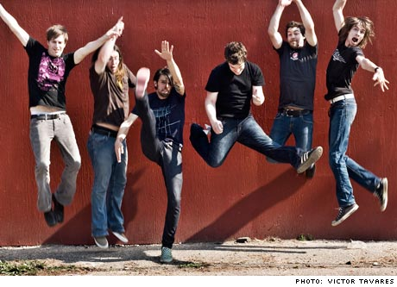
Oh I wanna shout it out From every roof top sing For now I know that God is
for me not against me!

Slide 228
Oh I could sing unending songs
Of how You saved my soul
Well I could dance a thousand miles
Because of Your great love

Slide 229
C’mon, everybody dance!

Slide 230
Everybody's singin' now.... cause we're so happy
Everybody's dancin' now.... cause we're so free!

Slide 231
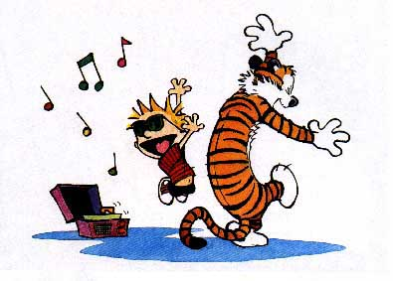
If only we could see His face And see Him smilin' over us As unseen Angels celebrate,
cause joy's in this place!

Slide 232
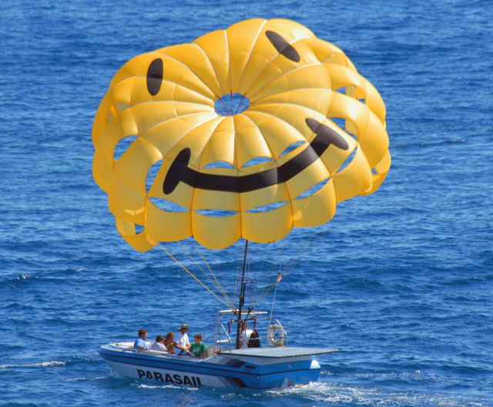
Oh I could sing unending songs
Of how You saved my soul
Well I could dance a thousand miles
Because of Your great love (x2)

Slide 233
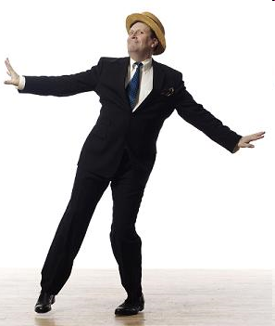
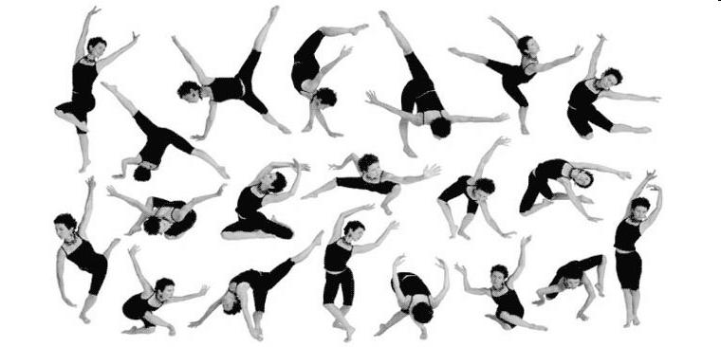
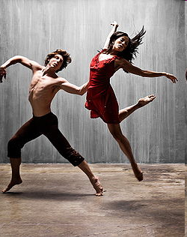
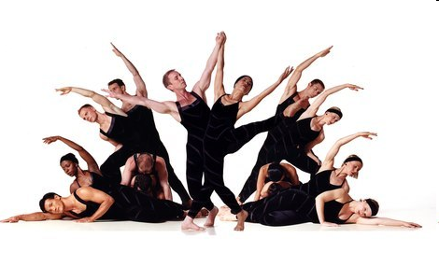
Oh, I could dance a thousand miles for you, my Lord!
Oh, I could dance a thousand miles for you, my Lord!
(end)

Slide 235
INTERMISSION

Slide 236
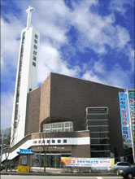
WANSAN CHURCH
Service Time: 4:00pm Sunday
Location: 2nd floor of Edu. Bld.
Pastor: Richard Hamm

Slide 237
Hosanna

Slide 238
Praise is rising,
eyes are turning to You,
we turn to You
Hope is stirring,
hearts are yearning for You,
we long for You

Slide 239
'Cause when we see You,
we find strength
to face the day
In Your Presence
all our fears are
washed away, washed away

Slide 240
Ho- san- na, ho- sanna
You are the God Who saves us,
worthy of all our praises

Slide 241
Ho- san- na, ho- sanna
Come have Your way among us
We welcome You here, Lord Jesus

Slide 242
Hear the sound of
hearts returning to You,
we turn to You
In Your Kingdom
broken lives are made new,
You make us new

Slide 243
'Cause when we see You,
we find strength
to face the day
In Your Presence
all our fears are
washed away, washed away

Slide 244
Ho- san- na, ho- sanna
You are the God Who saves us,
worthy of all our praises

Slide 245
Ho- san- na, ho- sanna
Come have Your way among us
We welcome You here, Lord Jesus

Slide 247
'Cause when we see You,
we find strength
to face the day
In Your Presence
all our fears are
washed away

Slide 248
'Cause when we see You,
we find strength
to face the day
In Your Presence
all our fears are
washed away

Slide 249
washed away

Slide 250
Ho- san- na, ho- sanna
You are the God Who saves us,
worthy of all our praises

Slide 251
Ho- san- na, ho- sanna
Come have Your way among us
We welcome You here, Lord Jesus

Slide 252
Ho- san- na, ho- sanna
You are the God Who saves us,
worthy of all our praises

Slide 253
Ho- san- na, ho- sanna
Come have Your way among us
We welcome You here, Lord Jesus

Slide 254
Hosanna!

Slide 255
Hosanna!

Slide 256
Hosanna!

Slide 257
Hosanna!

Slide 259
Only a God like You

Slide 260
For the praises of man
I will never, ever stand,

Slide 261
For the kingdoms of this world I'll never give my heart away or shout my praise

Slide 262
My allegiance and devotion,
my heart's desire and all emotion

Slide 263
go to serve the Man
who died upon that tree.

Slide 264
Only a God like You,
could be worthy of my praise
and all my hope and faith,

Slide 265
To only a King of all kings,
do I bow my knee and sing,
give my ev'rything

Slide 266
Only a God like You,
could be worthy of my praise
and all my hope and faith,

Slide 267
To only a King of all kings,
do I bow my knee and sing,
give my ev'rything

Slide 268
To only my Maker,
my Father, my Savior,
Redeemer, Restorer,
Rebuilder, Rewarder,

Slide 269
To only a God like You,
Do I give my praise

Slide 270
For the praises of man
I will never, ever stand,

Slide 271
For the kingdoms of this world I'll never give my heart away or shout my praise

Slide 272
My allegiance and devotion,
my heart's desire and all emotion

Slide 273
go to serve the Man
who died upon that tree.

Slide 274
Only a God like You,
could be worthy of my praise
and all my hope and faith,

Slide 275
To only a King of all kings,
do I bow my knee and sing,
give my ev'rything

Slide 276
Only a God like You,
could be worthy of my praise
and all my hope and faith,

Slide 277
To only a King of all kings,
do I bow my knee and sing,
give my ev'rything

Slide 278
To only my Maker,
my Father, my Savior,
Redeemer, Restorer,
Rebuilder, Rewarder,

Slide 279
To only a God like You,
Do I give my praise

Slide 280
Only a God like You,
only a God like You,
only a God like You.

Slide 281
Only a God like You,
only a God like You,
only a God like You.

Slide 282
Only a God like You,
only a God like You,
only a God like You.

Slide 283
Only a God like You,
only a God like You,
only a God like You.

Slide 284
Only a God like You,
only a God like You,
only a God like You.

Slide 285
Only a God like You,
only a God like You,
only a God like You.

Slide 286
To only my Maker,
my Father, my Savior,
Redeemer, Restorer,
Rebuilder, Rewarder,

Slide 287
To only a God like You,
Do I give my praise

Slide 289
All to You

Slide 290
You called me Lord,
You know my name
I'm standing out,
I'm not ashamed

Slide 291
I've searched and came up empty
This world has nothing for me

Slide 292
You are my one and only
I'm living my life for You

Slide 293
And I'm giving everything to You
Not holding back, from every part
I'm giving it all to You

Slide 294
You are the Lord of all I am
And, I'll never be the same again

Slide 295
I've searched and came up empty
This world has nothing for me
You are my one and only

Slide 296
I'm living my life for You
And I'm giving everything to You

Slide 297
Not holding back, from every part
I'm giving it all to You

Slide 298
I'm living my life for You
And I'm giving everything to You

Slide 299
Not holding back, from every part
I'm giving it all to You

Slide 301
I'm living my life for You
And I'm giving everything to You

Slide 302
Not holding back, from every part
I'm giving it all to You

Slide 303
I'm living my life for You
And I'm giving everything to You

Slide 304
Not holding back, from every part
I'm giving it all to You

Slide 306
Blessed

Slide 307
Blessed are those
who dwell in Your house.
They are ever praising You.

Slide 308
Blessed are those
whose strength is in You.
Whose hearts are set on our God

Slide 309
Blessed are those
who dwell in Your house.
They are ever praising You.

Slide 310
Blessed are those
whose strength is in You.
Whose hearts are set on our God

Slide 311
Blessed are those
who dwell in Your house.
They are ever praising You.

Slide 312
Blessed are those
whose strength is in You.
Whose hearts are set on our God

Slide 313
We will go from
strength to strength
until we see You face to face

Slide 314
Hear our prayer,
O Lord, God Almighty
Come bless our land
as we seek You, worship You

Slide 316
Blessed are those
who dwell in Your house.
They are ever praising You.

Slide 317
Blessed are those
whose strength is in You.
Whose hearts are set on our God

Slide 318
We will go from
strength to strength
until we see You face to face

Slide 319
Hear our prayer,
O Lord, God Almighty
Come bless our land
as we seek You, worship You

Slide 320
Hear our prayer,
O Lord, God Almighty
Come bless our land
as we seek You, worship You

Slide 322
For You are holy,
For You are holy,
For You are holy, Lord

Slide 323
For You are holy,
For You are holy,
For You are holy, Lord

Slide 324
For You are holy,
For You are holy,
For You are holy, Lord

Slide 325
For You are holy,
For You are holy,
For You are holy, Lord

Slide 326
For You are holy,
For You are holy,
For You are holy, Lord

Slide 327
For You are holy,
For You are holy,
For You are holy, Lord

Slide 328
Hear our prayer,
O Lord, God Almighty
Come bless our land
as we seek You, worship You

Slide 329
Hear our prayer,
O Lord, God Almighty
Come bless our land
as we seek You, worship You

Slide 330
Hear our prayer,
O Lord, God Almighty
Come bless our land
as we seek You, worship You

Slide 331
Hear our prayer,
O Lord, God Almighty
Come bless our land
as we seek You, worship You

Slide 333
Your name

Slide 334
As morning dawns
and evening fades
You inspire songs of praise

Slide 335
That rise from earth
to touch your heart
And glorify your name

Slide 336
Your name
Is a strong and mighty tower
Your name
Is a shelter like no other

Slide 337
Your name
Let the nations sing It louder
Cause nothing has the power
to save
But your name

Slide 339
Jesus in Your name we pray
Come and fill our hearts today

Slide 340
Lord give us strength to live for You
And glorify your name

Slide 341
Your name
Is a strong and mighty tower
Your name
Is a shelter like no other

Slide 342
Your name
Let the nations sing It louder
Cause nothing has the power
to save
But your name

Slide 343
Your name
Is a strong and mighty tower
Your name
Is a shelter like no other

Slide 344
Your name
Let the nations sing It louder
Cause nothing has the power
to save
But your name

Slide 346
Your name
Is a strong and mighty tower
Your name
Is a shelter like no other

Slide 347
Your name
Let the nations sing It louder
Cause nothing has the power
to save
But your name

Slide 348
Your name
Is a strong and mighty tower
Your name
Is a shelter like no other

Slide 349
Your name
Let the nations sing It louder
Cause nothing has the power
to save
But your name

Slide 350
Your name
Is a strong and mighty tower
Your name
Is a shelter like no other

Slide 351
Your name
Let the nations sing It louder
Cause nothing has the power
to save
But your name

Slide 352
Amazing Grace
(My chains are gone)

Slide 353
AMAZING GRACE (MY CHAINS ARE GONE)

Slide 354
Amazing grace
How sweet the sound
That saved a wretch like me

Slide 355
I once was lost,
but now I'm found
Was blind, but now I see

Slide 356
'Twas grace that taught
my heart to fear
And grace my fears relieved

Slide 357
How precious did
that grace appear
The hour I first believed

Slide 358
My chains are gone
I've been set free
My God, my Savior
has ransomed me

Slide 359
And like a flood
His mercy reigns
Unending love,
Amazing grace

Slide 360
The Lord has promised
good to me
His word my hope secures

Slide 361
He will my shield
and portion be
As long as life endures

Slide 362
My chains are gone
I've been set free
My God, my Savior
has ransomed me

Slide 363
And like a flood
His mercy reigns
Unending love,
Amazing grace

Slide 364
My chains are gone
I've been set free
My God, my Savior
has ransomed me

Slide 365
And like a flood
His mercy reigns
Unending love,
Amazing grace

Slide 366
The earth shall soon
dissolve like snow,
the sun for bear to shine.

Slide 367
But God who called
me here below
will be forever mine.

Slide 368
will be forever mine.
You are forever mine

Slide 369
My chains are gone
I've been set free
My God, my Savior
has ransomed me

Slide 370
And like a flood
His mercy reigns
Unending love,
Amazing grace

Slide 371
My chains are gone
I've been set free
My God, my Savior
has ransomed me

Slide 372
And like a flood
His mercy reigns
Unending love,
Amazing grace

Slide 373
My chains are gone
I've been set free
My God, my Savior
has ransomed me

Slide 374
And like a flood
His mercy reigns
Unending love,
Amazing grace

Slide 375
Unending love,
Amazing grace

Slide 376
Unending love,
Amazing grace

Slide 378
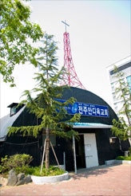
ANTIOCH CHURCH
Service Time: 10:30am Sunday
Location: 2nd floor of Moriah Sanctuary
Pastors: Jae-Bum Heo, Brian Kilduff
Contact: Georgia Bryant

Slide 379
HERE I AM TO WORSHIP

Slide 380
Verse 1:
Light of the world You stepped down into darkness. Opened my eyes, let me see.

Slide 381
Beauty that made this heart adore You Hope of a life spent with You

Slide 382
Chorus:
Here I am to worship, Here I am to bow down, Here I am to say that You’re my God

Slide 383
You’re altogether lovely Altogether worthy, Altogether wonderful to me

Slide 384
Verse 2:
King of all days, Oh, so highly exalted Glorious in heaven above

Slide 385
Humbly You came to the Earth You created All for love’s sake became poor

Slide 386
Bridge:
I’ll never know how much it cost To see my sin upon that cross

Slide 387
HERE I AM again

Slide 388
Verse 1:
Here I am again just looking for the words to help me say that My heart is full of love and praises

Slide 389
I must have prayed a thousand prayers and sung a hundred songs But I just have to say again

Slide 390
Chorus:
Oh, how, I love You More than words can say In the deepest, heartfelt way!

Slide 391
Oh, how, Lord, I love You Once again receive my praise!

Slide 392
Verse 2:
So many words, so many songs So many melodies yet Allow me one more declaration

Slide 393
You are the lover of my soul The center of my life So, I just have to say again

Slide 394
Bridge 1:
Thank you for a brand new day A brand new chance to stand and say, “I love You”

Slide 395
Bridge 2:
Help me find the words to say That tell You in a brand new way “I love You”

Slide 396
sweeter

Slide 397
Chorus:
Everyday with You, Lord is sweeter than the day before (x2)

Slide 398
Every morning I will worship, Every evening I’ll adore

Slide 399
‘Cause everyday with You is sweeter, sweeter than the day before!

Slide 400
Verse 1:
What a privilege to know You, like I know You To be loved like You loved me

Slide 401
What an honor to worship, truly worship From this heart that You have freed

Slide 402
From the rising of the sun to the setting of the same

Slide 403
Verse 2:
What a wonder to live life, really live life. Overcoming anything.

Slide 404
What a reason to lift up, freely lift up Everyday my everything

Slide 405
From the rising of the sun to the setting of the same

Slide 406
Bridge:
Everyday, everyday with You, Lord Everyday, sweeter than the day before

Slide 407
How great is our god

Slide 408
Verse 1:
The splendor of a King, clothed in majesty Let all the Earth rejoice, all the Earth rejoice

Slide 409
He wraps himself in light, and darkness tries to hide. It trembles at His voice, trembles at His voice

Slide 410
Chorus:
How great is our God, sing with me How great is our God, and all will see How great, how great, is our God.

Slide 411
Verse 2:
Age to age He stands, and time is in His hands. Beginning and the End, Beginning and the End.

Slide 412
The Godhead, three in one, Father, Spirit, Son, the Lion and the Lamb, the Lion and the Lamb.

Slide 413
Bridge:
You’re the Name above all names You are worthy of all praise And my heart will sing, “How great is our God!”

Slide 414
Hymn:
Then sings my soul, My Savior, God, to Thee, “How great Thou art!” “How great Thou art!”

Slide 415
God of this city

Slide 416
Verse 1:
You’re the God of this city You’re the King of these people You’re the Lord of this nation You Are

Slide 417
You’re the light in this darkness You’re the hope to the hopeless You’re the peace to the restless You Are

Slide 418
Bridge:
For there is no one like our God There is no one like You, God!

Slide 419
Chorus:
Greater things have yet to come And greater things are still to be done In this city! (x3)

Slide 420
Greater things have yet to come And greater things are still to be done here

