Slide 4
2 Corinthians 3:17
“Where the Spirit of the
Lord is, there is
FREEDOM!”

Slide 5
Salvation is Here

Slide 6
God above all
the world in motion
God above all
my hopes and fears

Slide 7
I don’t care
what the world
throws at me now
It’s gonna be alright

Slide 8
Hear the sound
of the generations
Making loud
our freedom song

Slide 9
All in all
that the world would
know Your name
It’s gonna be alright

Slide 10
‘Cause I know
my God saved the day
And I know
His word never fails

Slide 11
And I know
my God made a way for me
Salvation is here!

Slide 12
God above all
the world in motion
God above all
my hopes and fears

Slide 13
I don’t care
what the world
throws at me now
It’s gonna be alright

Slide 14
‘Cause I know
my God saved the day
And I know
His word never fails

Slide 15
And I know
my God made a way for me

Slide 16
‘Cause I know
my God saved the day
And I know
His word never fails

Slide 17
And I know
my God made a way for me
Salvation is here!

Slide 18
Salvation is here!
Salvation is here!
and He lives in me!

Slide 19
Salvation is here!
Salvation that died
just to set me free!

Slide 20
Salvation is here!
Salvation is here!
and He lives in me!

Slide 21
Salvation is here!

Slide 22
‘Cause You are alive
and You live in me
Salvation is here!

Slide 23
Salvation is here
and it lives in me
Salvation is here!

Slide 24
‘Cause I know
my God saved the day
And I know
His Word never fails

Slide 25
And I know
my God made a way for me
Salvation is here!

Slide 26
Salvation is here!

Slide 28
Arms of Love

Slide 29
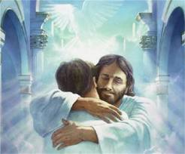
I sing a simple song of love
To my Savior, to my Jesus
I’m grateful for
the things you’ve done
My loving Savior,
my precious Jesus

Slide 30
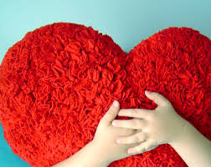
My heart is glad
that you’ve called me your own
There’s no place I’d rather be

Slide 31
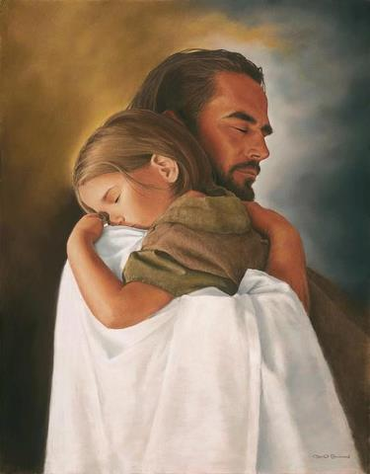
In your arms of love,
In your arms of love
Holding me still,
Holding me near
In your arms of love

Slide 32
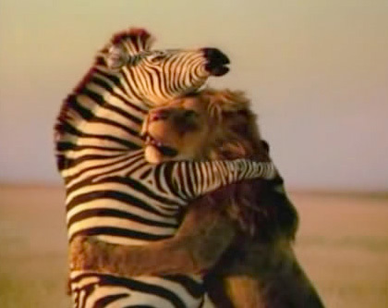
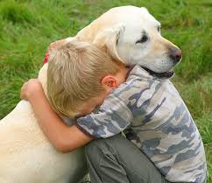
I sing a simple song of love
To my Savior, to my Jesus
I’m grateful for
the things you’ve done
My loving Savior,
my precious Jesus

Slide 33
My heart is glad
that you’ve called me your own
There’s no place I’d rather be

Slide 34
In your arms of love,
In your arms of love
Holding me still,
Holding me near
In your arms of love

Slide 35
My heart is glad
that you’ve called me your own
There’s no place I’d rather be

Slide 36
In your arms of love.
[6x]

Slide 37
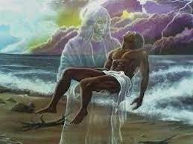
Holding me still, Holding me near
Holding me still, Holding me near
Holding me still, Holding me near
In your arms of love .

Slide 38
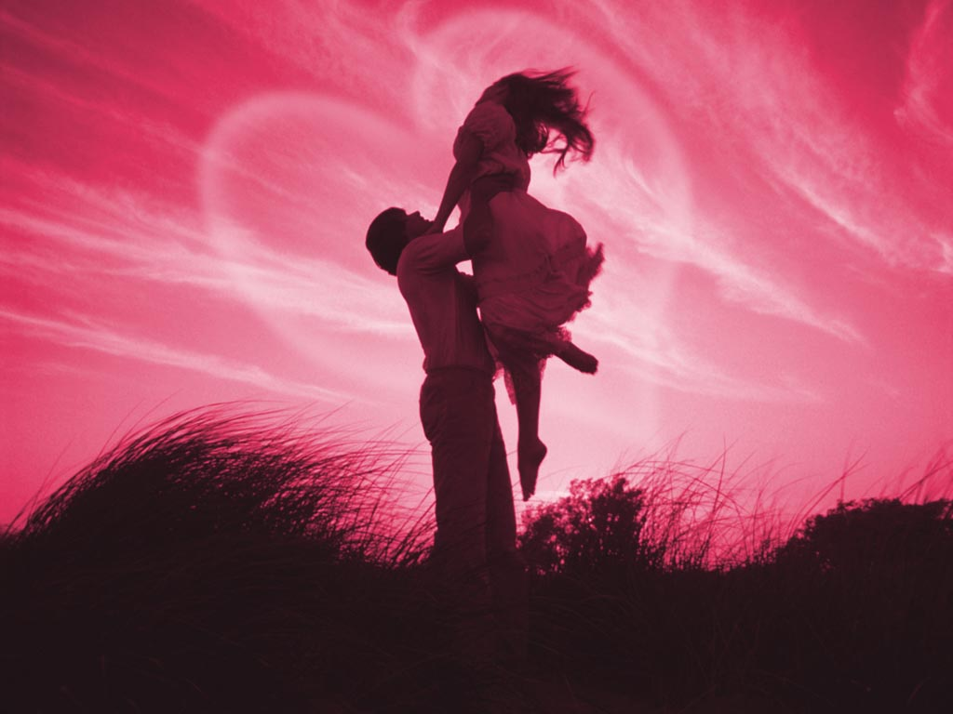
Holding me still, Holding me near
Holding me still, Holding me near
Holding me still, Holding me near
In your arms of love .

Slide 40
Stronger

Slide 41
There is love that came for us
Humbled to a sinner’s cross
You broke my shame
and sinfulness
You rose again victorious

Slide 42
Faithfulness none can deny
Through the storm
and through the fire
There is truth that sets me free
Jesus Christ who lives in me

Slide 43
You are stronger, You are stronger
Sin is broken, You have saved me
It is written, Christ is risen
Jesus You are Lord of all

Slide 44
No beginning and no end
You’re my hope and my defense
You came to seek and save the lost
You paid it all upon the cross

Slide 45
You are stronger, You are stronger
Sin is broken, You have saved me
It is written, Christ is risen
Jesus You are Lord of all

Slide 46
So let Your name
be lifted higher
be lifted higher
be lifted higher

Slide 47
You are stronger, You are stronger
Sin is broken, You have saved me
It is written, Christ is risen
Jesus You are Lord of all

Slide 49
Here I Am to Worship

Slide 50
Light of the world,
you stepped down into darkness.
Opened my eyes, let me see.
Beauty that made
this heart adore you
Hope of a life spent with You.

Slide 51
Here I am to worship,
here I am to bow down.
Here I am to say that You’re my God.
You’re altogether lovely,
altogether worthy,
altogether wonderful to me.

Slide 52
King of all days,
Oh so highly exalted
Glorious in Heaven above.
Humbly You came
to the earth You created
All for love’s sake became poor.

Slide 53
Here I am to worship,
here I am to bow down.
Here I am to say that You’re my God.
You’re altogether lovely,
altogether worthy,
altogether
wonderful to me.

Slide 54
I’ll never know how much it cost
To see my sins up on that cross.
(3x)

Slide 55
Here I am to worship,
here I am to bow down.
Here I am to say that You’re my God.
You’re altogether lovely,
altogether worthy,
altogether wonderful
to me! -end-

Slide 58
Exodus 15:1
“I will sing to the Lord for
He has Triumphed
Gloriously!”

Slide 59
Your Great Name

Slide 60
Lost are saved;
find their way;
at the sound
of Your great name
Verse 1

Slide 61
All condemned;
feel no shame,
at the sound
of Your great name
Verse 1

Slide 62
Every fear;
has no place;
at the sound
of Your great name
Verse 1

Slide 63
The enemy;
he has to leave;
at the sound
of Your great name
Verse 1

Slide 64
Jesus, Worthy is the Lamb
that was slain for us,
Son of God and Man
You are high and lifted up;
and all the world will praise
Your great name
Chorus

Slide 65
All the weak;
find their strength;
at the sound
of Your great name
Verse 2

Slide 66
Hungry souls;
receive grace;
at the sound
of Your great name
Verse 2

Slide 67
The fatherless;
they find their rest;
at the sound
of Your great name
Verse 2

Slide 68
Sick are healed;
and the dead are raised;
at the sound
of Your great name
Verse 2

Slide 69
Redeemer, My Healer,
Lord Almighty
My savior, Defender,
You are My King
Bridge

Slide 71
Jesus Messiah

Slide 72
He became sin
Who knew no sin
That we might become
His Righteousness
He humbled himself and
carried the cross
Verse 1

Slide 73
Love so amazing
Love so amazing
Pre-Chorus

Slide 74
Jesus Messiah
Name above all names
Blessed Redeemer
Emmanuel
Chorus

Slide 75
The rescue for sinners
The ransom from Heaven
Jesus Messiah
Lord of all
Chorus

Slide 76
His body the bread
His blood the wine
Broken and poured out
all for love
The whole earth trembled
And the veil was torn
Verse 2

Slide 77
All our hope is in You
All our hope is in You
All the glory to You, God
The light of the world
Bridge

Slide 79
Our God

Slide 80
Water You turned into wine
Opened the eyes of the blind
There’s no one like You
None like You
Verse 1

Slide 81
Into the darkness You shine
Out of the ashes we rise
There’s no one like You
None like You
Verse 1

Slide 82
Chorus
Our God is greater,
Our God is stronger
God You are higher
than any other
Our God is Healer,
awesome in power
Our God, Our God

Slide 83
And if Our God is for us,
then who could ever stop us?
And if our God is with us,
then what can stand against?
(x2)
What can stand against?
Bridge

Slide 85
Freedom

Slide 86
Where the spirit of the Lord is
there is freedom
Verse 1

Slide 87
There is peace,
There is love,
There is joy
It is for freedom,
you've set us free
(x2)
Verse 1

Slide 88
I’m free, I’m free!
Verse 1

Slide 89
Verse 1
We will walk
in your freedom,
walk in your liberty (x2)
We will dance
in your freedom,
dance in your liberty (x2)

Slide 91
10,000 Reasons (Bless the Lord)

Slide 92
Bless the Lord, O my soul
O my soul
Worship His holy name
Sing like never before
O my soul
I worship Your holy name
Chorus

Slide 93
The sun comes up;
it's a new day dawning
It's time to sing
Your song again
Verse 1

Slide 94
Whatever may pass and
whatever lies before me
Let me be singing
when the evening comes
Verse 1

Slide 95
You're rich in love and
You're slow to anger
Your name is great and
Your heart is kind
Verse 2

Slide 96
For all Your goodness,
I will keep on singing
10,000 reasons
for my heart to find
Verse 2

Slide 97
And on that day
when my strength is failing
The end draws near and
my time has come
Verse 3

Slide 98
Still my soul will sing
Your praise unending
10,000 years
and then forever more
Verse 3

Slide 99
Sing like never before
O my soul
I worship Your holy name
I worship Your holy name
I worship Your holy name
Ending

Slide 102
Revelation 1:5
“To Him who loves us
and has FREED us from
our sins by His blood.”

Slide 103
For All You’ve Done

Slide 104
My Saviour, Redeemer
Lifted me from the miry clay
Almighty, Forever

Slide 105
I will never be the same
Cause You came near
From the everlasting
To the world we live
The father’s only Son

Slide 106
You lived, and You died
You rose again on high
You’ve opened the way
For the world to live again
Hallelujah, for all You’ve done

Slide 107
Bridge
Hallelujah,
For all You’ve done
Hallelujah
For all You’ve done

Slide 109
I Am Free

Slide 110
Through You the blind will see,
Through You the mute will sing
Through You the dead will rise,
Through You my heart will praise,

Slide 111
Through You the darkness flees,
Through You my heart screams
I am free I am free

Slide 112
I am free to run
(I am free to run)
I am free to dance
(I am free to dance)
I am free to live for you
(I am free to live for you)
I am free

Slide 114
With All I Am

Slide 115
Into Your hands,
I commit again
All I am for You Lord
You hold my world in the
palm of Your hands
And I am Yours Forever

Slide 116
Chorus
Jesus, I believe in You
Jesus I belong to you
You’re the reason that I live
The reason that I sing
With all I am

Slide 117
II. I walk with You,
whenever You will go
Through tears and joy
I’ll trust in You
And I will live in all of
Your ways
Your promises forever

Slide 118
Chorus
Jesus, I believe in You
Jesus I belong to you
You’re the reason that I live
The reason that I sing
With all I am

Slide 119
Bridge
I will worship
I will worship, You

Slide 121
Jesus, Lover of My Soul

Slide 122
Jesus lover of my soul
Jesus I will never let you go
You’ve taken me
from the miry clay
You set my feet upon the rock
now I know

Slide 123
Chorus
I love you, I need you
Though my world may fall
I’ll never let You go
My Saviour, My closest Friend
I will worship You
Until the very end

Slide 127
Galatians 5:1
“It is for FREEDOM that
Christ has set us FREE!”

Slide 128
Our God Saves

Slide 129
In the name of the Father,
In the name of the Son,
In the name of the Spirit,
Lord we come

Slide 130
We’re gathered together
To lift up Your Name
To call on our Savior,
To fall on Your grace

Slide 131
Hear the joyful sound
of our offering
As your saints bow down,
As your people sing
We will rise with you,
Lifted on Your wings
And the world will see that

Slide 132
Our God saves, Our God saves
There is hope, In Your name
Mourning turns,
To songs of Praise
Our God saves, Our God saves

Slide 133
In the name of the Father,
In the name of the Son,
In the name of the Spirit,
Lord we come

Slide 134
We’re gathered together
To lift up Your Name
To call on our Savior,
To fall on Your grace

Slide 135
Hear the joyful sound
of our offering
As your saints bow down,
As your people sing
We will rise with you,
Lifted on Your wings
And the world will see that

Slide 136
Our God saves, Our God saves
There is hope, In Your name
Mourning turns,
To songs of Praise
Our God saves, Our God saves

Slide 138
Overcome

Slide 139
Seated above, enthroned
in the Father’s love
Destined to die,
poured out for all mankind
God’s only Son,
perfect and spotless one
He never sinned,
but suffered as if he did

Slide 140
All authority,
every victory is Yours
All authority,
every victory is Yours

Slide 141
Savior worthy of honor and glory
Worthy of all our praise,
You overcome
Jesus, awesome in power forever
Awesome and great is your name
You overcame

Slide 142
Seated above, enthroned
in the Father’s love
Destined to die,
poured out for all mankind
God’s only Son,
perfect and spotless one
He never sinned,
but suffered as if he did

Slide 143
All authority,
every victory is Yours
All authority,
every victory is Yours

Slide 144
Savior worthy of honor and glory
Worthy of all our praise,
You overcome
Jesus, awesome in power forever
Awesome and great is your name
You overcame

Slide 145
Power in hand,
speaking the Father’s plan
You’re sending us out
light in this broken land

Slide 146
All authority,
every victory is Yours
All authority,
every victory is Yours

Slide 147
Savior worthy of honor and glory
Worthy of all our praise,
You overcome
Jesus, awesome in power forever
Awesome and great is your name
You overcame

Slide 148
We will overcome
By the blood of the lamb
And the word of our testimony,
Everyone overcome

Slide 149
Savior worthy of honor and glory
Worthy of all our praise,
You overcome
Jesus, awesome in power forever
Awesome and great is your name
You overcame

Slide 151
Agnus Dei

Slide 152
Alleluia, Alleluia
For the Lord God Almighty
Reigns (3X)

Slide 153
Alleluia, You are Holy
Holy, are you Lord God Almighty
Worthy is the Lamb
Worthy is the Lamb
Amen

Slide 155
Break Every Chain

Slide 156
There is power in the name of Jesus
There is power in the name of Jesus
There is power in the name of Jesus
To Break every Chain
Break every chain
Break every chain

Slide 157
All sufficient sacrifice
so freely given, such a price for
Our redemption,
heavens gate swing wide

Slide 158
There is power in the name of Jesus
There is power in the name of Jesus
There is power in the name of Jesus
To Break every Chain
Break every chain
Break every chain

Slide 159
There’s an army rising up
There’s an army rising up
There’s an army rising up

Slide 160
There is power in the name of Jesus
There is power in the name of Jesus
There is power in the name of Jesus
To Break every Chain
Break every chain
Break every chain

Slide 163
John 8:36
“So if the Son sets you
FREE, you will be free
indeed.”

Slide 164
Genesis 39:2-5: Everyday
New International Version (NIV)
² The Lord was with Joseph so that he prospered, and he lived in the house of his Egyptian master. ³ When his master saw that the Lord was with him and that the Lord gave him success in everything he did, ⁴ Joseph found favor in his eyes and became his attendant. Potiphar put him in charge of his household, and he entrusted to his care everything he owned. ⁵ From the time he put him in charge of his household and of all that he owned, the Lord blessed the household of the Egyptian because of Joseph. The blessing of the Lord was on everything Potiphar had, both in the house and in the field.
164

Slide 165
Everyday

Slide 166
What to say, Lord?
It’s You who gave me life and I
Can’t explain just how
Much You mean to me now
166

Slide 167
That You have saved me, Lord
I give all that I am to You
That everyday I could
Be a light that shines
Your name
167

Slide 168
Everyday, Lord, I’ll
Learn to stand upon Your word
And I pray that I
I might come to
know You more
168

Slide 169
That You would guide me
in every single step I take, that
Everyday I can
Be Your light unto the world
169

Slide 170
Everyday, it’s You I live for
Everyday, I’ll follow after You
Everyday, I’ll walk with You,
my Lord
170

Slide 171
Everyday, Lord, I’ll
Learn to stand upon Your word
And I pray that I
I might come to
know You more
171

Slide 172
That You would guide me
in every single step I take, that
Everyday I can
Be Your light unto the world
172

Slide 173
Everyday, it’s You I live for
Everyday, I’ll follow after You
Everyday, I’ll walk with You,
my Lord
173

Slide 175
Genesis 45:7: Your Name
New International Version (NIV)
⁷ But God sent me ahead of you to preserve for you a remnant on earth and to save your lives by a great deliverance.

Slide 176
Your Name

Slide 177
As morning dawns
and evening fades
You inspire songs of praise
That rise from earth
To touch Your heart
And glorify Your Name

Slide 178
Your Name is a strong & mighty tower
Your Name is a shelter like no other
Your Name let the nations sing it louder
‘Cause nothing has the power to save
But Your Name

Slide 179
Jesus in Your Name we pray
Come and fill our hearts today
Lord give us strength to live for You
And glorify Your Name

Slide 180
Your Name is a strong & mighty tower
Your Name is a shelter like no other
Your Name let the nations sing it louder
‘Cause nothing has the power to save
But Your Name

Slide 182
Genesis 39:20-21: Through It All
New International Version (NIV)
²⁰ Joseph’s master took him and put him in prison, the place where the king’s prisoners were confined. But while Joseph was there in the prison, ²¹ the Lord was with him; he showed him kindness and granted him favor in the eyes of the prison warden.
Notes:
182
182

Slide 183
Through it All

Slide 184
Halle-lujah
Halle-lujah
Halle-lujah
Halle-lujah
Notes:
184
184

Slide 185
You are forever in my life
You see me through the seasons
Cover me with Your hand
And lead me in Your
righteousness
Notes:
185
185

Slide 186
And I look to You
And I wait on You
Notes:
186
186

Slide 187
I’ll sing to You Lord
A hymn of Love
For Your faithfulness to me
I’m carried in everlasting arms
You’ll never let me go
Through it all
Notes:
187
187

Slide 188
Halle-lujah
Halle-lujah
Halle-lujah
Halle-lujah
Notes:
188
188

Slide 190
Philippians 1:6: Jesus You Are
New International Version (NIV)
⁶ being confident of this, that he who began a good work in you will carry it on to completion until the day of Christ Jesus.
190

Slide 191
Jesus You Are

Slide 192
Jesus You are You are
Ev’rything I’m not
And ev’rything that I want to be
192

Slide 193
Jesus You are You are
The maker of my heart
Finish what You started in me
193

Slide 194
Jesus You are You are
Ev’rything I’m not
And ev’rything that I
want to be
194

Slide 195
Jesus You are You are
The maker of my heart
Finish what You started in me
195

Slide 196
This is the hope I have
It’s something I cannot see
You willingly gave Your life
Willing to die for me
196

Slide 197
Now I believe
I believe
I believe
197

Slide 198
Jesus You are You are
Ev’rything I’m not
And ev’rything that I
want to be
198

Slide 199
Jesus You are You are
The maker of my heart
Finish what You started in me
199

Slide 201
1 Corinthians 15:57
“Thanks be to God, who
gives us the VICTORY
through our Lord Jesus
Christ!”

Slide 202
Victory in Jesus

Slide 203
I heard an old, old story,
How a Savior came from glory,
How He gave His life
on Calvary
To save a wretch like me;
Verse 1

Slide 204
I heard about His groaning, Then I repented of my sins; And won the victory.
Verse 1

Slide 205
O victory in Jesus, My Savior, forever. He sought me and bought me With His redeeming blood; He loved me ere I knew Him, And all my love is due Him, He plunged me to victory, Beneath the cleansing flood

Slide 206
I heard about His healing,
Of His cleansing power
revealing. How He made the lame
to walk again
And caused the blind to see;
Verse 2

Slide 207
And then I cried, “Dear Jesus,
Come and heal
my broken spirit,”
And somehow Jesus
came and brought
To me the victory.
Verse 2

Slide 208
O victory in Jesus, My Savior, forever. He sought me and bought me With His redeeming blood; He loved me ere I knew Him, And all my love is due Him, He plunged me to victory, Beneath the cleansing flood

Slide 209
I heard about a mansion
He has built for me in glory.
And I heard about
the streets of gold
Beyond the crystal sea;
Verse 3

Slide 210
About the angels singing,
And the old redemption story,
And some sweet day
I'll sing up there
The song of victory.
Verse 3

Slide 211
O victory in Jesus, My Savior, forever. He sought me and bought me With His redeeming blood; He loved me ere I knew Him, And all my love is due Him, He plunged me to victory, Beneath the cleansing flood

